Slide 1
Presentation on Micro credit defaulter project
By Pratyush Ghosh

Slide 2
Problem statement
A microfinance institution (MFI) is an organization that offers financial services to low income populations. MFS becomes very useful when targeting especially the unbanked poor families living in remote areas with not much sources of income. The microfinance services (MFS) provided by MFI are group loans, agricultural loans, individual business loans and so on.
Here in this project we need to build a model which can be used to predict in terms of a probability for each loan transaction, whether the customer will be paying back the loaned amount within 5 days of insurance of loan. In this case, label ‘1’ indicates that the loan has been payed i.e. Non- defaulter, while, label ‘0’ indicates that the loan has not been payed i.e. Defaulter.

Slide 3
I have loaded the dataset in jupyter notebook from given file, checking the shape of the data I came to know that the data set contains huge number of samples. It has arround 2,09,593 rows and 37 different columns. Below is the list of all columns.
'unnamed: 0', 'label', 'msisdn', 'aon', 'daily_decr30', 'daily_decr90', 'rental30', 'rental90', 'last_rech_date_ma', 'last_rech_date_da', 'last_rech_amt_ma', 'cnt_ma_rech30', 'fr_ma_rech30', 'sumamnt_ma_rech30', 'medianamnt_ma_rech30', 'medianmarechprebal30', 'cnt_ma_rech90', 'fr_ma_rech90', 'sumamnt_ma_rech90', 'medianamnt_ma_rech90', 'medianmarechprebal90', 'cnt_da_rech30', 'fr_da_rech30', 'cnt_da_rech90', 'fr_da_rech90', 'cnt_loans30', 'amnt_loans30', 'maxamnt_loans30', 'medianamnt_loans30', 'cnt_loans90', 'amnt_loans90', 'maxamnt_loans90', 'medianamnt_loans90', 'payback30', 'payback90', 'pcircle', 'pdate'

Slide 4
Findings and Assumptions
After loading the data, I have ensured that whether there is any null value present in the dataset. And luckily we are not having null values in the data. Observing the data info I recognize that data set has 3 columns with object data type and others are integer and float types.
After checking data description and distribution plots for every feature-
Looking at the counts from every columns once again it ensures that there are no null values.
looking at the minimum value I observe many columns with negative entries which is not realistic, I have dropped these values and by dropping these values I am losing 5 to 6% of the data.
Looking at max count of every column and distribution plot, I observed that much of the columns are filled very large values which are unrealistic so I am using percentile method to replace these values

Slide 5
Data Processing
we don’t need columns named ‘Unnamed 0’, and ‘msisdn’. Because column ‘Unnamed 0’ contains index numbers and column ‘msisdn’ contains contact numbers of customers. So these two columns are no way contributing to label prediction. So I dropped both these columns.
Column ‘aon’ contains age on cellular network in days, for better understanding I have converted this data into years, by dividing this column by 365.
Column pcircle has single unique entry throughout its length so I decided to drop this column
And pdate column is having dates by using this column I created separate columns for day, months and year and dropped earlier pdate column.
After that checking the value count for Year column I got to know that all the data is from same year 2016, so I dropped this column

Slide 6
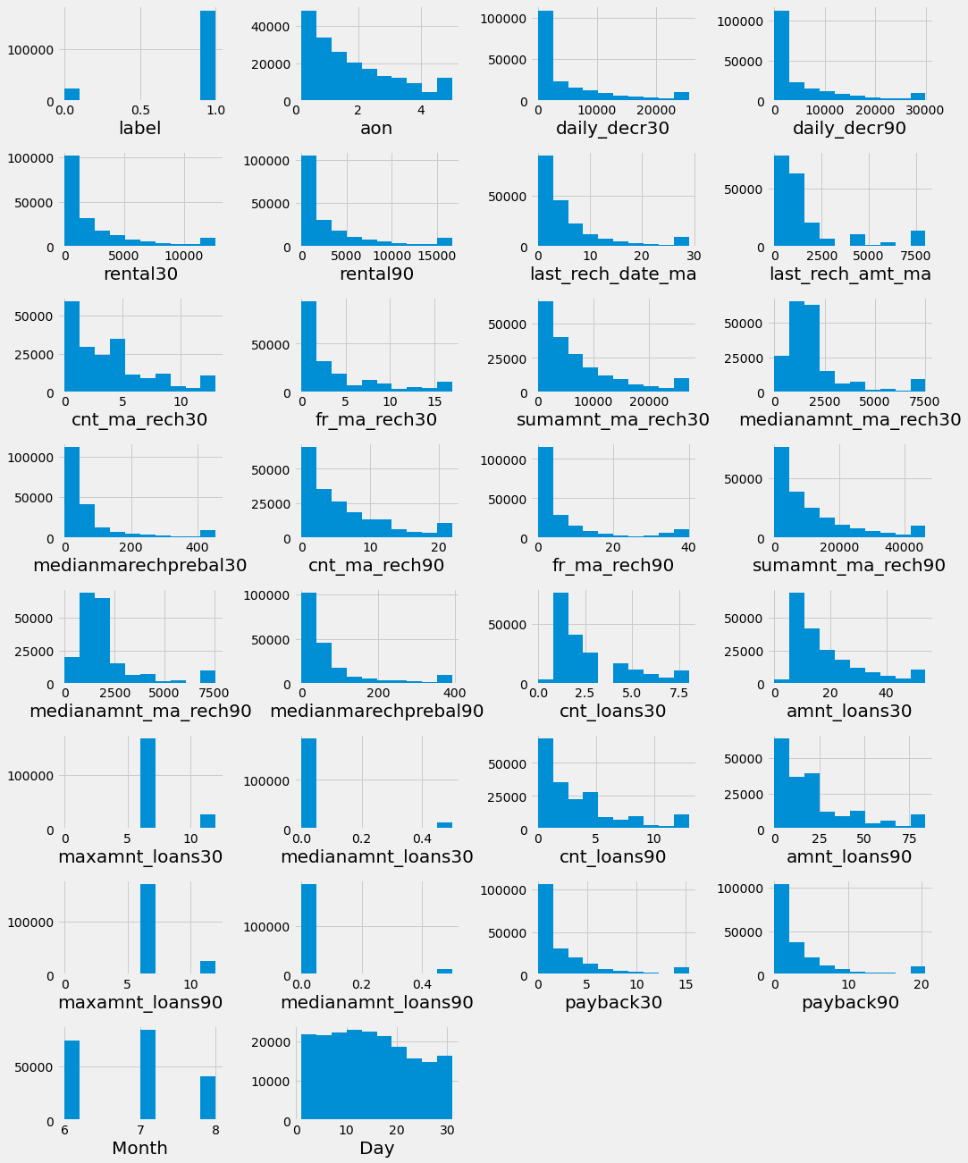
Visualization
At first I have plotted distribution plot for every column and got to know about unrealistic data which will affect our predictions. And some of the columns are with only zero value are deleted.
After doing the data processing I plotted these histograms for columns. Looking at these plots we can see that now our data is in good range for building a machine learning model.

Slide 7
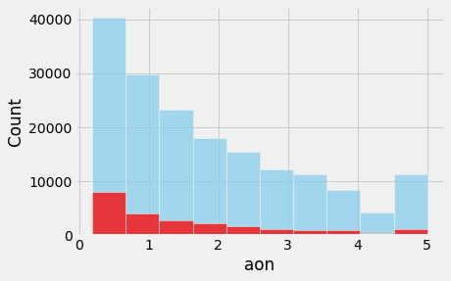
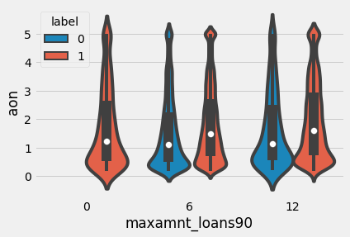
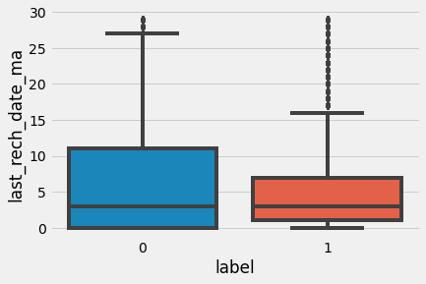
Looking at above hist plot for age of customers on cellular network in years; we can say that large numbers of customers are there who are using cellular network since around last 1 year and the rate of not paying back the credit amount in these people is higher than others.
Second violin plot represents the maximum amount of loan taken by the user in last 90 days. This violin plot tells us that when the loan taken in last 90 days is very less or near to zero they will pay back the credit amount within 5 days.
Third figure represents the box plot for number of days till last recharge of main account, as we see in this box plot more number of people who recharge their main account 6 to 12 days back are most likely not paying the loan amount.

Slide 8
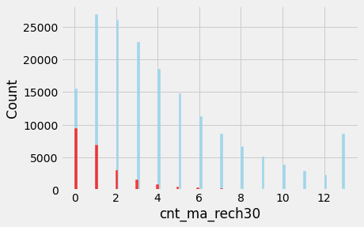
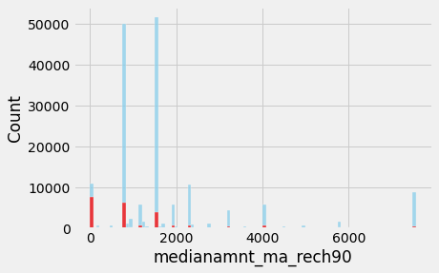
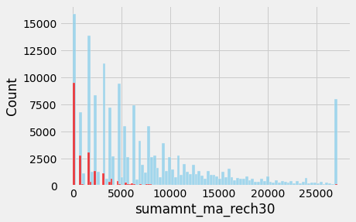
First figure shows histogram for number of times main account got recharged in last 30 days shows that when people didn’t recharge their main account or recharges only once in 30 days the rate of not paying back the credit amount is higher compared to others.
And looking at second histogram we can see that when median of amount of recharges done in main account over last 90 days at user level is 0, the ratio of customers to not to pay back the credit amount within 5 days is high.
Third figure represents total amount of recharge in main account over last 30 days . Looking at this plot we can say that customers who makes total amount of recharge in main account above 10000 are mostly paying back the credit amount within 5 days. And those who are making very less recharge have higher ratio of not paying back the credit amount.

Slide 9
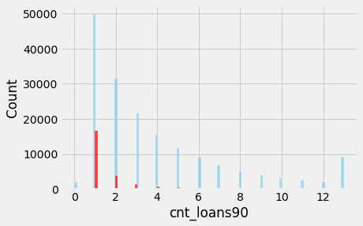
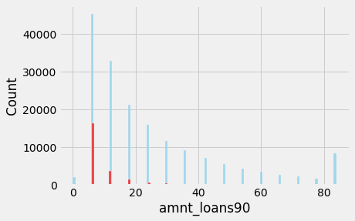
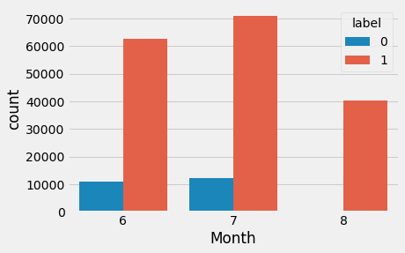
First figure represents number of loans taken by user in last 90 days, when a person takes loan amount once in last 90 days the chances of not paying back the credit amount within 5 days are higher.
Second figure represents total amount of loans taken by user in last 90 days, looking at this plot we can conclude that when total amount of loans taken by user in last 90 days is below 10; the chances of user not paying back the credit amount are more.
Third figure represents a count plot showing the month when customers have taken the loan. This will tell us that customers who have taken loans in the month of august they are paying back the credit amount within 5 day.

Slide 10
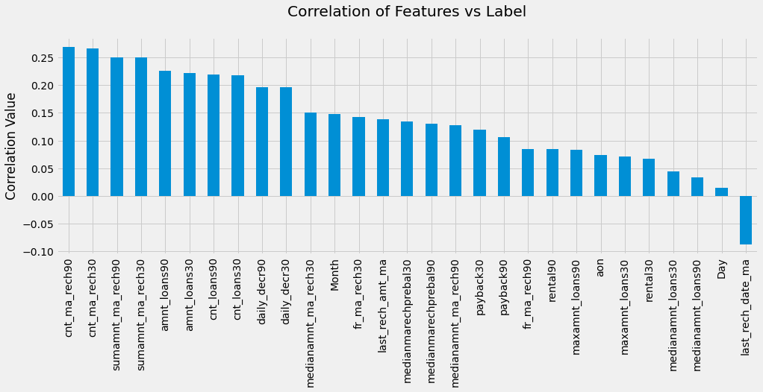
Correlation
Looking at above plot we can conclude that all features are having very less correlation with label, which is below 0.30.
cnt_ma_rech90 has maximum correlation with label.
Column Day is having least relation with the label.
And last_rech_date_ma is in negative relation with label.

Slide 11
Model Development
For Building Machine Learning model first I separated features and labels from our data set, and reduced skewness from the features. To bring all the features in common scale I scaled data using StandardScaler.
And then checked for problem of imbalance as our target variable contains binary data it is a classification problem. Using SMOTE I have done oversampling for the data and resolved the imbalance issue.
After that I find best random state for splitting our data into train and test part using logisticRegression algorithm and the same split is used for every algorithm.

Slide 12
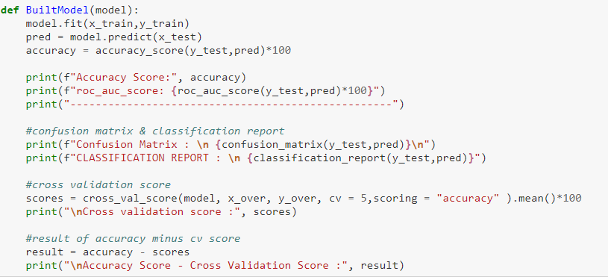
I have built a function to test every ML model with evaluation metrics

Slide 13
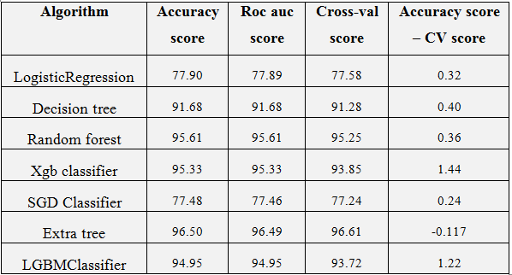
Important Observations
Looking at observations we came to know that ExtraTreeClassifier is giving highest accuracy score as well as least difference in accuracy and CV-score.

Slide 14
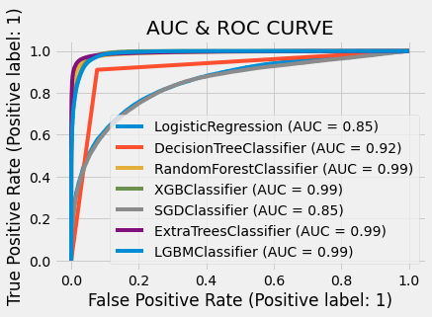
AUC ROC Curve
By observing AUC & ROC curve we can say that the model performance that means AUC of xgbclassifier, random forest, extra tree and lgbmclassifier is almost same. And among these four algorithms lgbmclassifier is giving better performance after hyperparameter tuning. So I have selected lgbmclassifier for our final model.

Slide 15
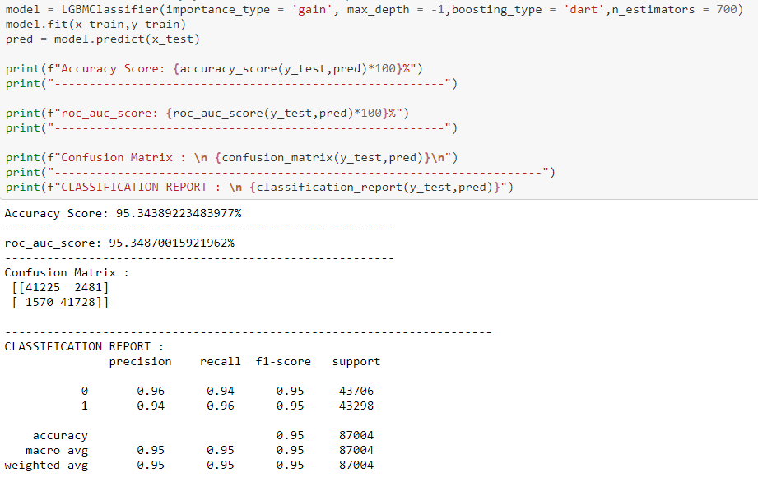
Final Model
After doing Hyperparameter tuning we have improved model accuracy from 94.95% to 95.35%

Slide 16
Conclusion
We started with loading the dataset, and checked for missing values; luckily we don’t have any missing values. But when we observed the data by describing and visualizing it we came to know that lot of the data is unrealistic. I dropped negative data and for the columns which are having too large values I used percentile method to replace those large values.
I used matplotlib and seaborn to visualize the data. And while data processing I created new columns and have dropped unwanted columns. After removing skewness and scaling the data I have build machine learning model and tested with different algorithms and selected a best model with lgbmclassifier algorithm.
As the data set is with many unrealistic values, there is still room for improvement, like doing a more extensive feature engineering, by comparing and plotting the features against each other and identifying and removing the noisy features. Another thing that can improve the overall result is to do more extensive hyperparameter tuning on several machine learning models.

Slide 17
Thank You

